Slide 1
Fresh Grads – Group Project
Electronics Shoppee

Slide 2
Problem Statement
To Create an Application for Electronic Shoppee
Customer can login, search, buy and order the electronic item.
Admin should be able to perform below operations:
1.Customer Management
2.Product Management
3.Order Management

Slide 3
Road Map
Application will be developed in following Sprints –
Core Java +JPA with Hibernate
Spring Boot + Rest Controller + JPA with Hibernate
Angular for UI design (Front End) + Integration with previous Sprint

Slide 4
Plan
Design
Generate the skeleton as per class design provided
TDD approach
Identify test cases for each module
Write Failing Test cases
Convert the Test Cases in GREEN
Implement the case study in incremental manner

Slide 5
Modules
Login Module
Customer Module
Manager Module
Electronic Product Module
Electronic Order Module

Slide 6
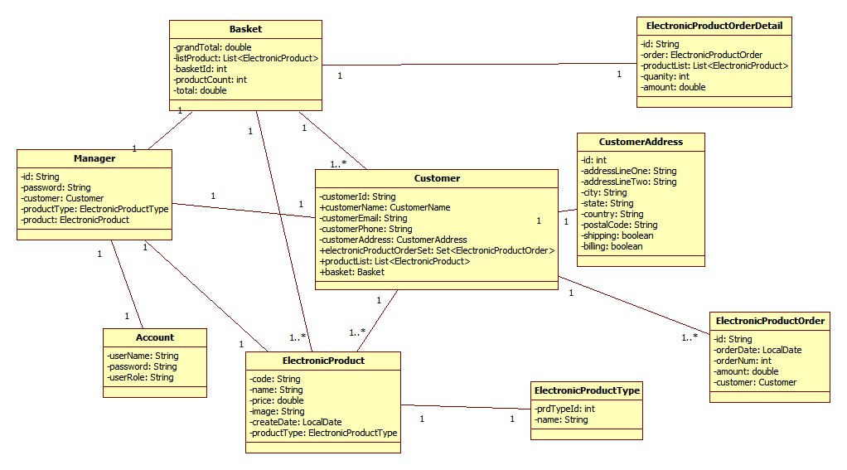
Class Design
POJO Classes:

Slide 7
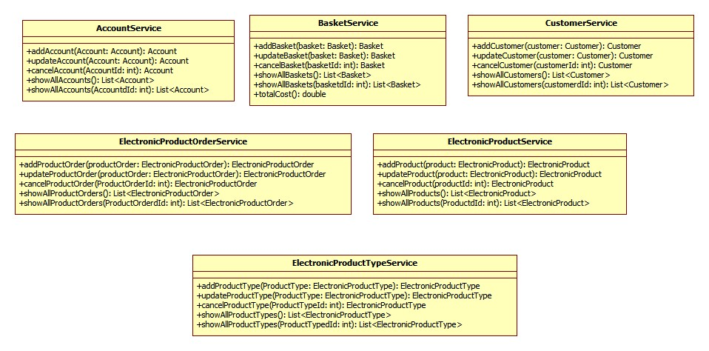
Class Design
Service Interface:

Slide 8
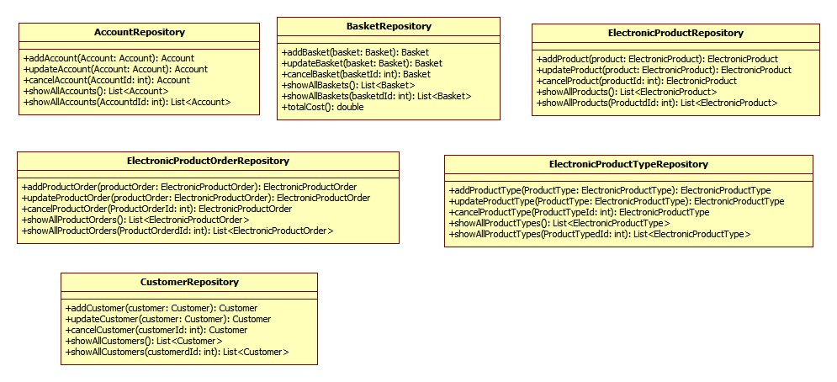
Class Design
Repository:

Slide 9




Questions

